Slide 1
NO BOUNDARIES!

Slide 2
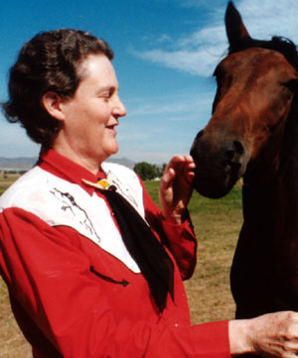
Scientist, Author, Speaker
Dr. Temple Grandin

Slide 3
NO BOUNDARIES!

Slide 4
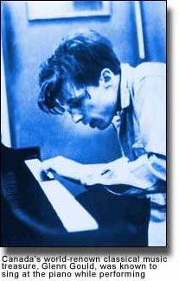
Glenn Gould, Canadian Pianist

Slide 5
NO BOUNDARIES!

Slide 6
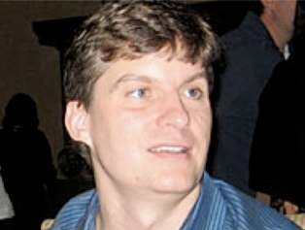
U.S. Investor and Fund Manager
Michael Burry

Slide 7
NO BOUNDARIES!

Slide 8
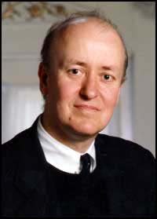
Pulitzer Prize Winner Critic
Tim Page

Slide 9
NO BOUNDARIES!

Slide 10
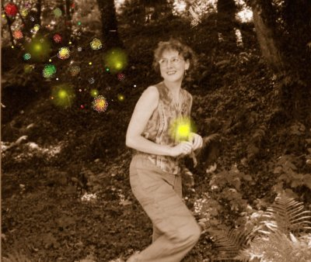
Author and Artist
Donna Williams

Slide 11
NO BOUNDARIES!

Slide 12
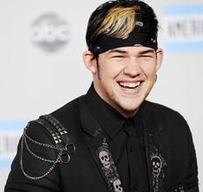
Singer and American Idol Finalist
James Durbin

Slide 13
NO BOUNDARIES!

Slide 14
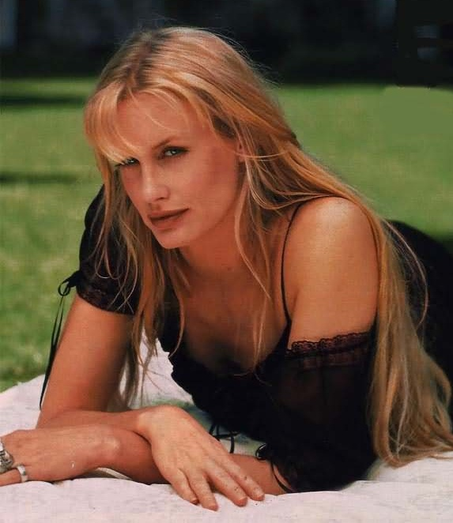
Actress
Darryll Hannah

Slide 15
NO BOUNDARIES!

Slide 16
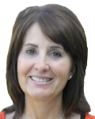
Educator and Author
Dr. Liane Holliday Willey

Slide 17
NO BOUNDARIES!

Slide 18
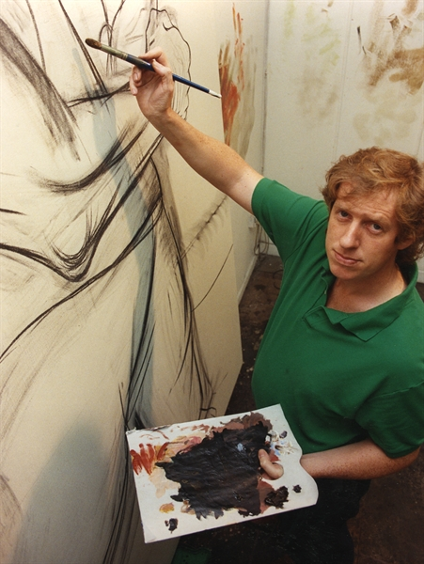
Artist
Peter Howson

Slide 19
NO BOUNDARIES!

Slide 20
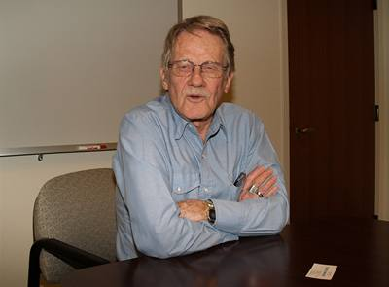
Nobel Laureate Economist
Vernon L. Smith

Slide 21
NO BOUNDARIES!

Slide 22
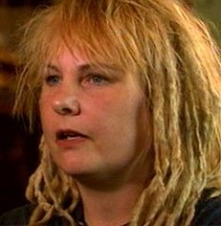
Anthropologist
Dawn Prince Hughes

Slide 23
NO BOUNDARIES!

Slide 24
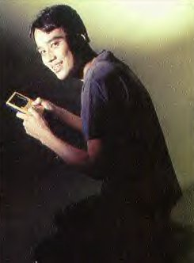
Creator of Pokeman
Satoshi Tajiri

Slide 25
NO BOUNDARIES!

Slide 26
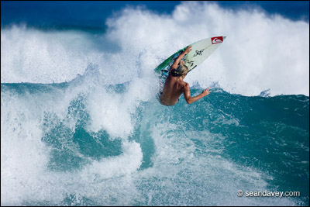
Surfer
Clay Marzo

Slide 27
NO BOUNDARIES!

Slide 28
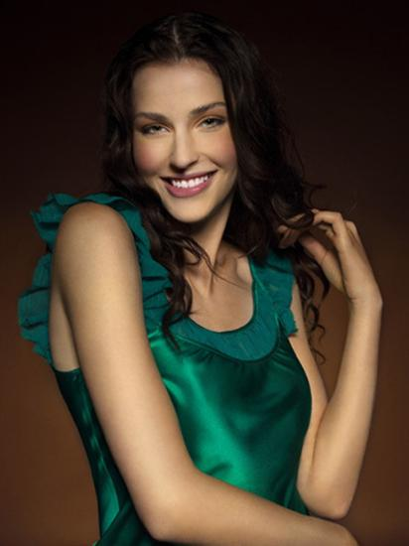
Model and America’s Next Top Model Finalist
Heather Kuzmich

Slide 29
NO BOUNDARIES!

Slide 30
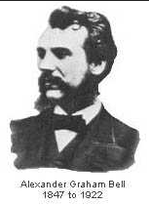
Alexander Graham Bell, Scottish/Canadian/American Inventor

